Slide 1
CNN (Convolutional Neural Network)
Ravitha N
AP / Dept of IT

Slide 2
Agenda
Introduction
Overview on Neural networks
Image Processing Task
Convolutional Network
State-of-art Networks
Object Detection Frameworks
Overview on Semantic Segmentation

Slide 3
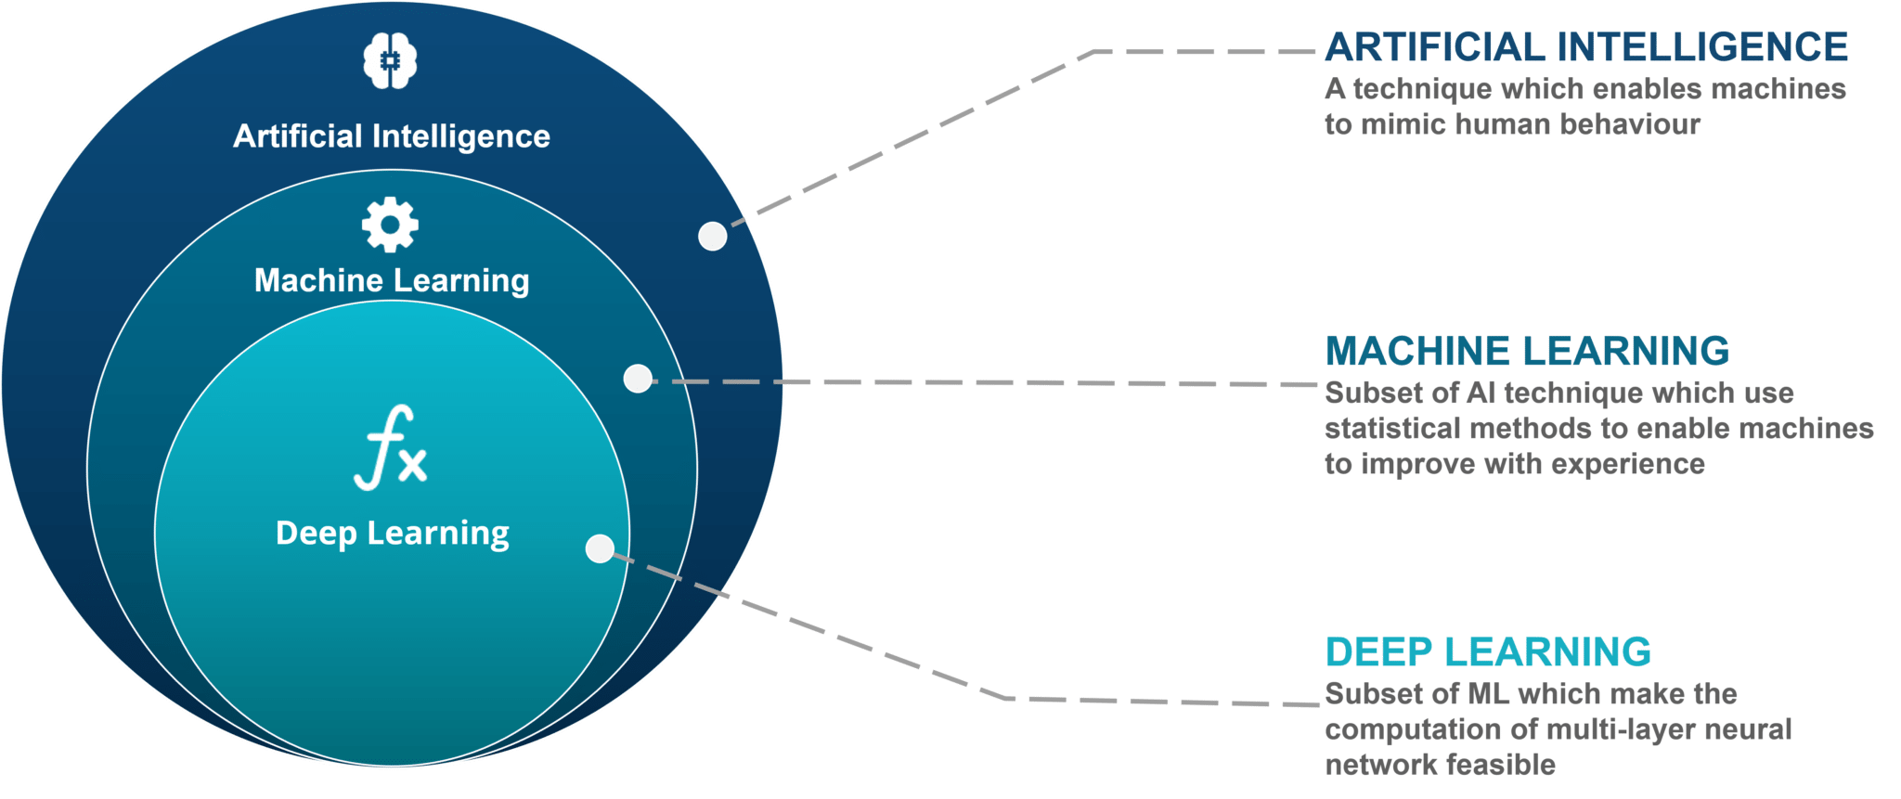
AI / ML/ DL
Learning , Reasoning and Perception

Slide 4
Problem : Always Find Y(output) from X(Input)
Given a text, can I identify the sentiment
Given an image, can I identify the class of the Image
Given a purchase history for a customer and a large inventory of products, identify those products which the customer is likely to purchase
Given a digital photo, identify the faces in the image

Slide 5

Supervised Learning
For any given task, Learning refers to Identification of a mathematical function which captures the relationship between the input(X) and the output(Y)
In a supervised learning setup, the algorithm learns using the sample set of data which are labeled (input and the expected output)
cat
f(I)
not a cat

Slide 6
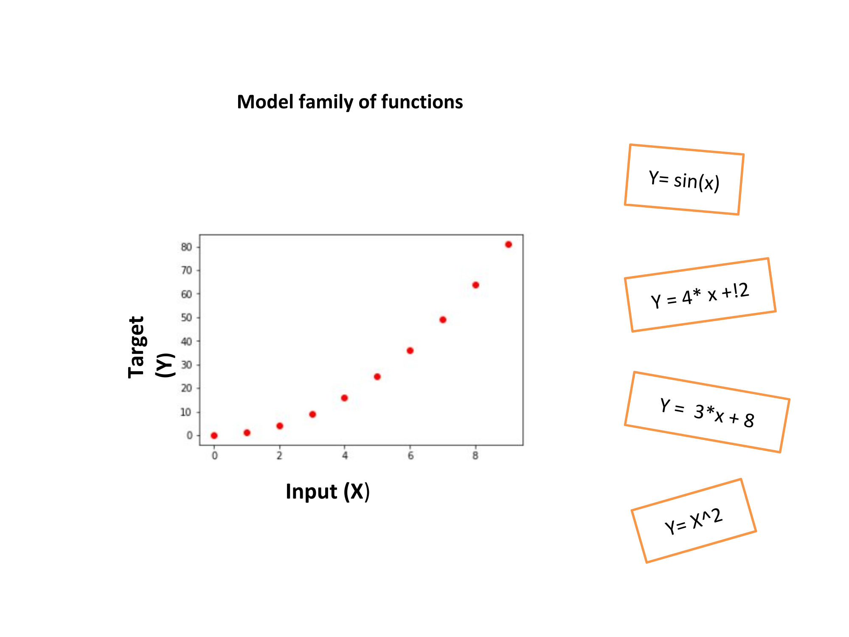
How to find f(I)??
ML Selects the type of function depending on the relation between them
Deep Learning – Function f(x) is modeled as a neural network (Number of layers are deeper!!)

Slide 7
If function is fixed, What will be learned??
Function will usually be guided by the parameters. Parameter values are learned by the algorithm
Fox example To learn y from x=[x1,x2,x3], Linear Regression selects a linear function to predict y
Y = w1 * x1 + w2 * x2 + w3 * x3
Here (w1,w2,w3) are known as parameters which will be learned from the data provided.

Slide 8
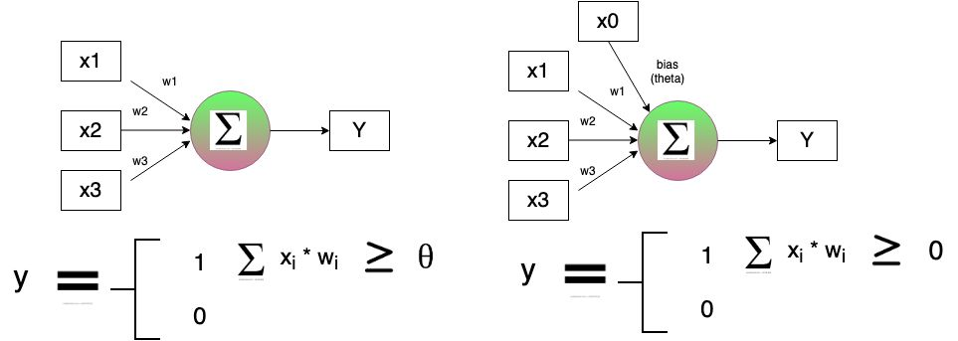
Neural Network
Minsky & Papert (1969) proposed a simple perceptron model which is designed for simulating the Boolean function. It lacks the ability to simulate non – linear functions like XOR and XNOR

Slide 9
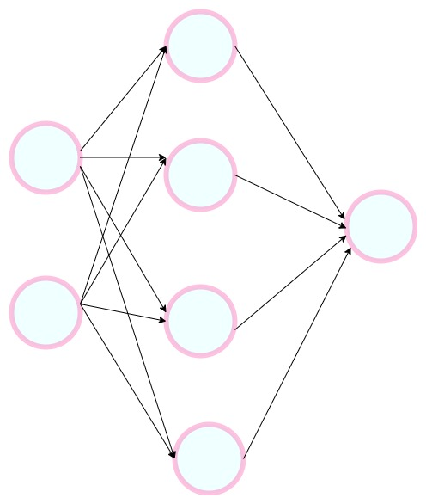
Multilayer Perceptron
Layer of neurons
Any boolean function of n inputs can be exactly represented by a network of perceptrons containing one hidden layer with 2^n perceptron and one output layer with 1 perceptron
But the real time application donot use boolean inputs
Sigmoid Neuron – accept n-dimensional Real input and can predict n-dimensional real output

Slide 10
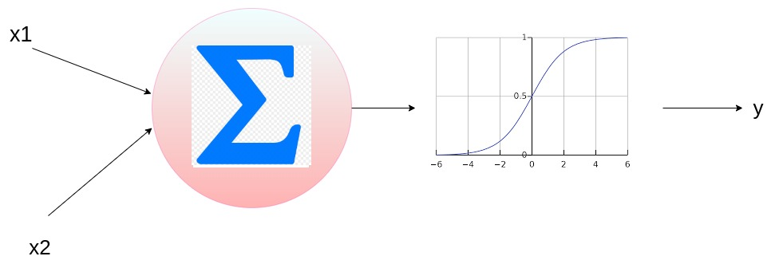
Sigmoid Neuron
Introduces non-linearity in the equation
Output produced is smooth and differentiable
Here bias is added to shift the activation function

Slide 11
Typical Machine Learning Setup
Data {Xi , Yi} I -> 1 to n
Model Yi = Fhat(x; w) complex function which is defined on the input and the parameters. Approximation of real time function
Parameters
Learning Algorithm
Learn Parameters of model
Gradient Descent
Define Loss function
This helps in the search of correct parameters

Slide 12
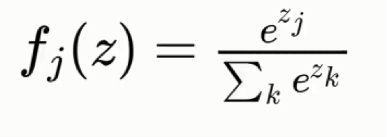
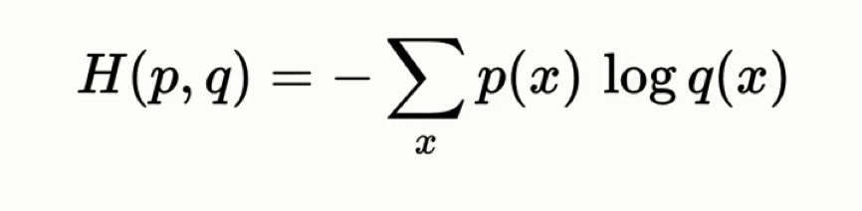
Classification
Softmax
Cross Entropy loss

Slide 13
How does Neural Network Learn?
Gradient Descent
Run the loop for specified number of epochs
{
For every sample in dataset:
Identify the output according to the model function (Forward Pass)
Compute Loss
Pass the gradient of the error function to the neuron
It then adjust the parameters based on the gradient and learning rate
W = w - (L) dw B = b - (L) db
}

Slide 14
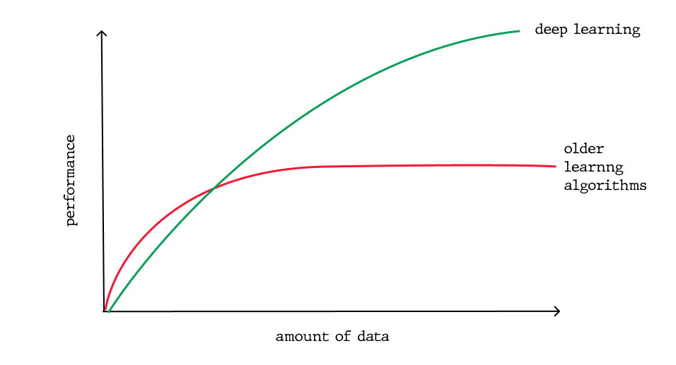
Aspects that differentiates DL and ML
Feature Engineering
Performance with increase in data
Domain Adaptability
Interpretability

Slide 15
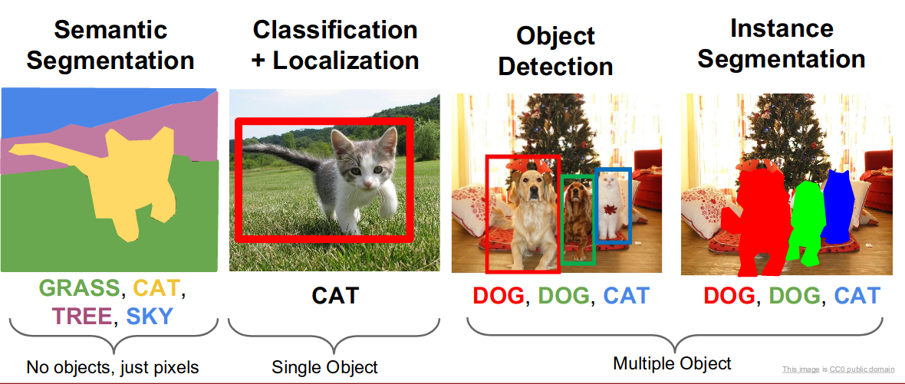
Computer Vision Tasks

Slide 16
Mechanism of Vision Hubel & Wiesel , 1959
Study on visual processing system of mammals
Placed electrodes on the primary visual cortex (region which is highly specialized for processing information about static and moving objects) of cat and recorded the response of different cells
There are different types of cells
Simple cells / Orientation cells / edge detectors
Respond to light orientation
Complex cells
Respond to light orientation and movement
Hypercomplex cells
Response to different lengths

Slide 17
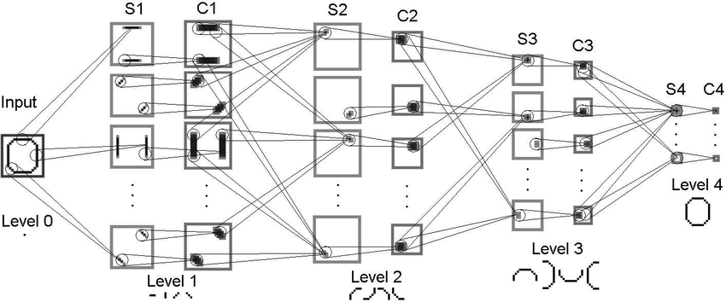
Neocognition Fukushima 1980
Features of increasing complexity are extracted in a hierarchical feed forward neural network
Local features are identified and they are gradually integrated in higher layers

Slide 18
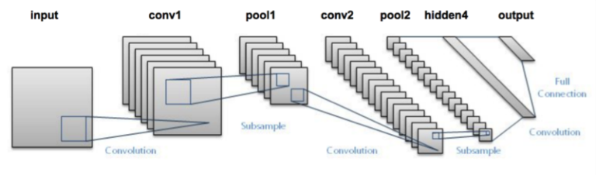
LeNet
LeNet is a Convolutional Neural Network used for Digit Recognition
Introduced Convolution and pooling layers

Slide 19
Fully connected vs Convolutional Neural Network
Sparse Connectivity
Few local neurons participate in the computation
As layers get deep, all pixels do interact with each layer
Weight sharing
Same weights are used in the generation of single feature map

Slide 20
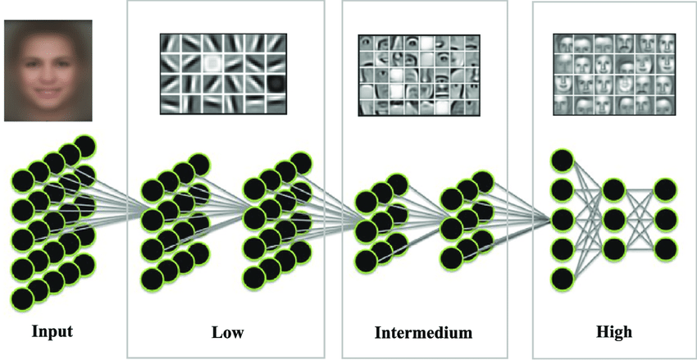
Convolutional Neural Network

Slide 21
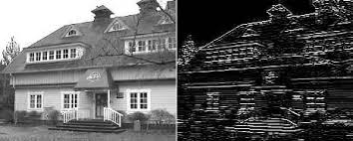
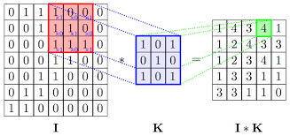
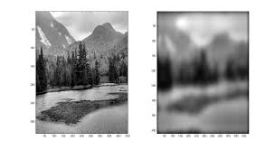
Convolution

Slide 22
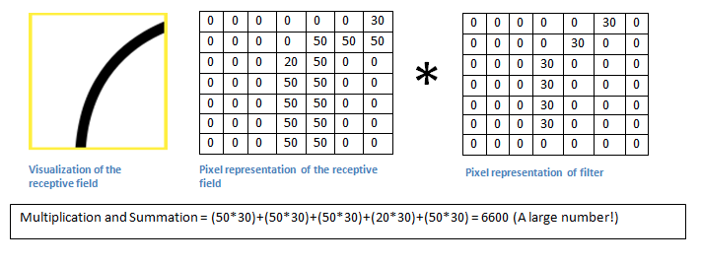
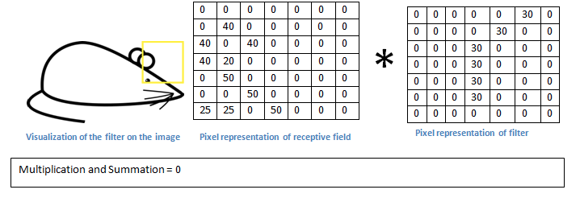

Slide 23
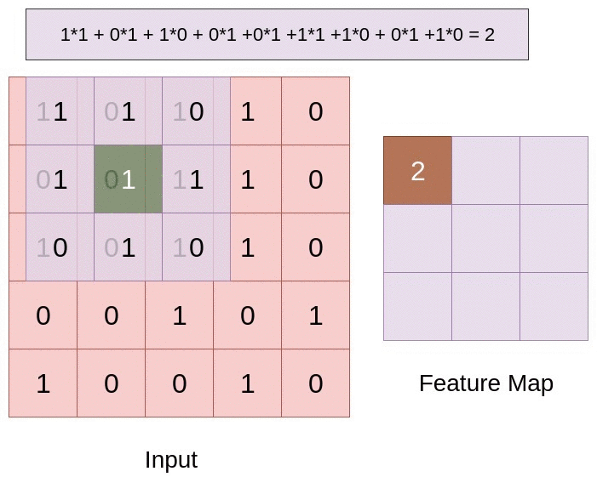
Convolution Operation

Slide 24
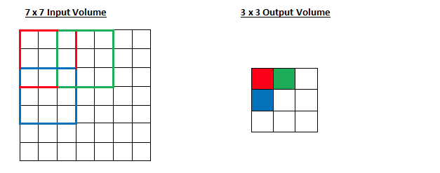
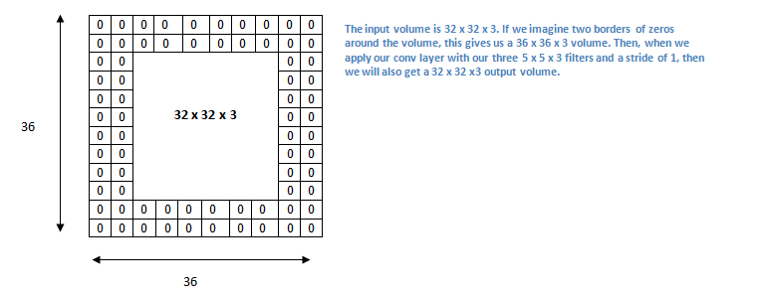

Hyperparameters of Convolution
Padding
Filter size
Stride

Slide 25
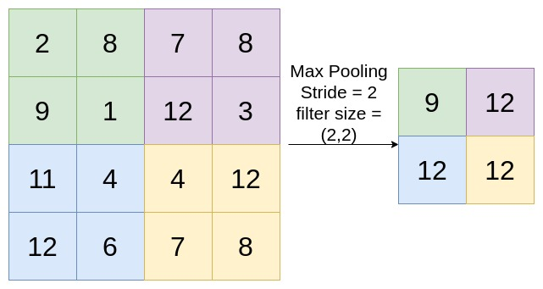
Pooling
Reduce the sample (or) feature size which increases the receptive field of the image at higher layers which in turn helps in the identification of higher level features
Hyperparameters:
Stride
Filter size

Slide 26
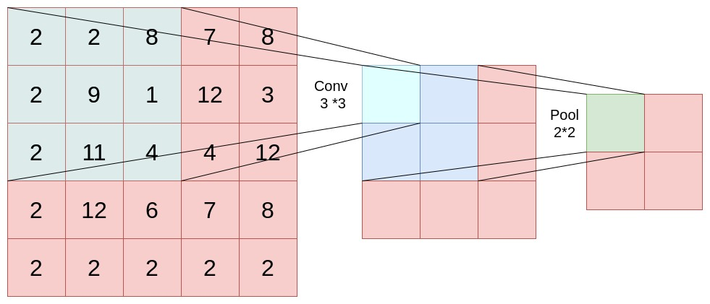
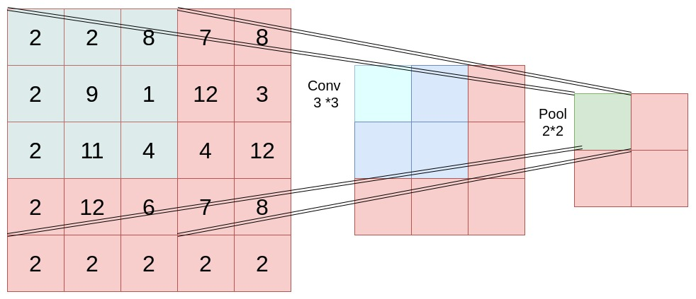
Increase in receptive field at the higher layers with the help of pooling

Slide 27
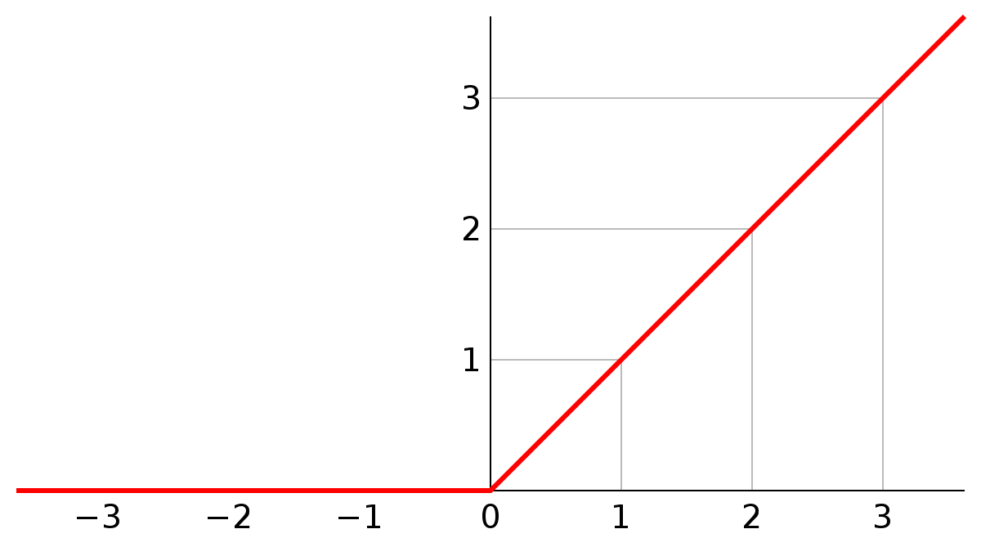
ReLU
SIgmoid Function will get saturated when its either close to zero (or) one
Faster and computationally efficient

Slide 28
Convolution Layer and Densely Connected Layer
dense layers learn global patterns in their input feature space
convolution layers learn local patterns
pool layers reduce spatial size of the input feature map

Slide 29
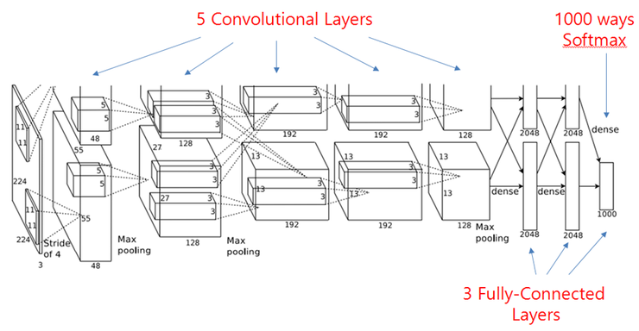
Alex Net(2012) Error rate : 15.6%
In the year 2012, Alex Krizhevsky with Hinton used CNN architecture for task of Image Classification in ILSVRC
They achieved an error rate of 15.6% which was an astounding improvement over ML counterparts which had registered an error rate of 26%

Slide 30

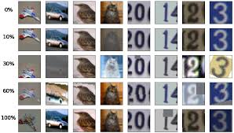
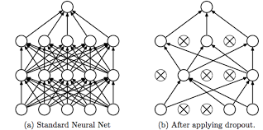
What made AlexNet to work on large scale dataset?
ReLU for non-linearity
Data Augmentation
Dropout Layers to avoid the problem of overfitting
Notes:
Image data augmentation is a technique that can be used to artificially expand the size of a training dataset by creating modified versions of images in the database
Training deep learning neural network models on more data can result in more skillful models, and the augmentation techniques can create variations of the images that can improve the ability of the fit models to generalize what they have learned to new images.

Slide 31
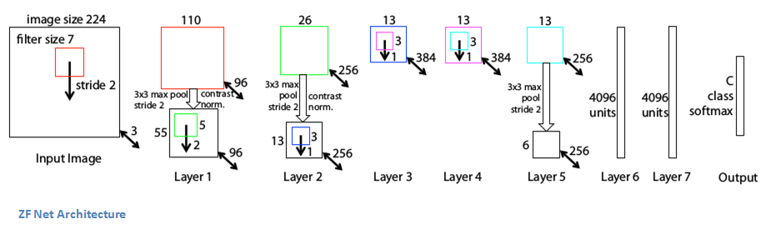
ZFNet(2013) Error rate : 11.7%
Visualizing and Understanding Convolutional Neural Networks
Used a smaller filter size in first layer of conv
Number of filters are increased as the network grows
Used Deconvolutional network to map the features to pixels

Slide 32
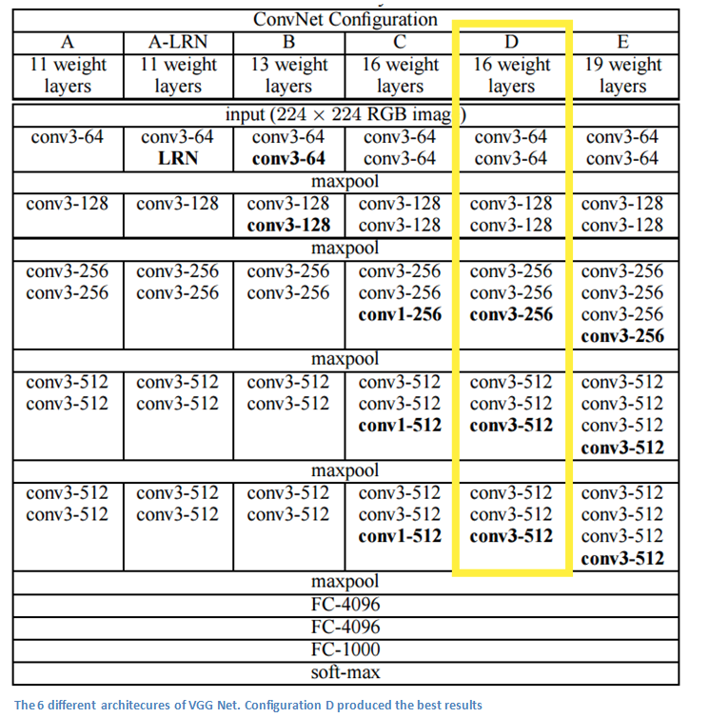
VGG Net (2014) Error rate : 7.5%
Used only 3*3 convolution layers
Two (or) three subsequent convolution layers before pooling for greater receptive field without loss of information
As spatial size decreases, depth increases
Added scale jittering data augmentation technique
Uses ReLU after every pooling layer

Slide 33
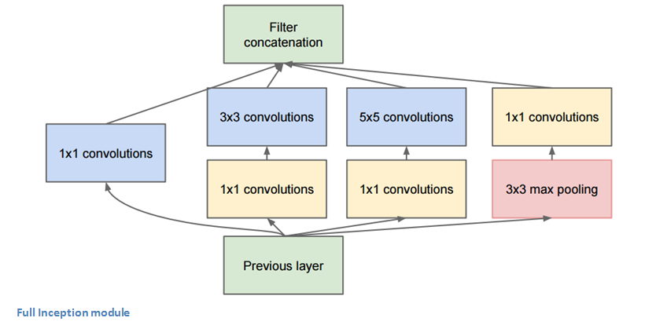
GoogLeNet(2014) Error rate : 6.7 %
22 layer network
The major contribution was the introduction of the inception module
Usage of 1*1 convolutions
Utilizing multiple parallel different convolutions offering multi scale representation of the image
Uses average pooling instead of fully connected layers thereby reducing the number of parameters

Slide 34
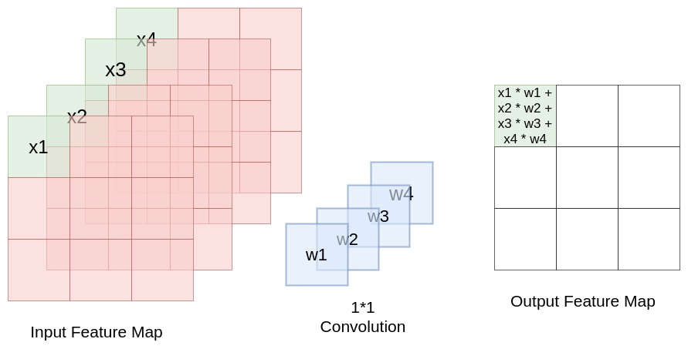
1*1 Convolution
Depth wise aggregation of values
Used for reducing the computations (parameters)

Slide 35
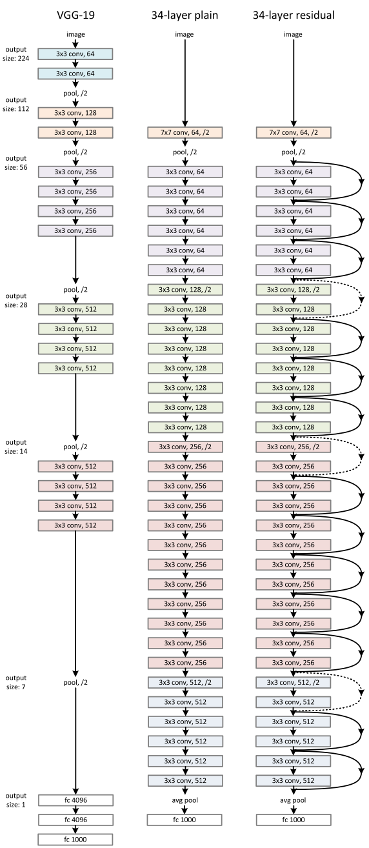
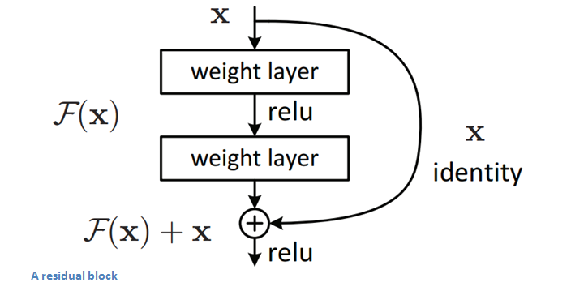
ResNet(2015) Error rate : 3.57%
152-layer network
Important Contribution was identifying that deeper networks perform badly than shallower counterparts
The problem is attributed to vanishing gradient problem

Slide 36
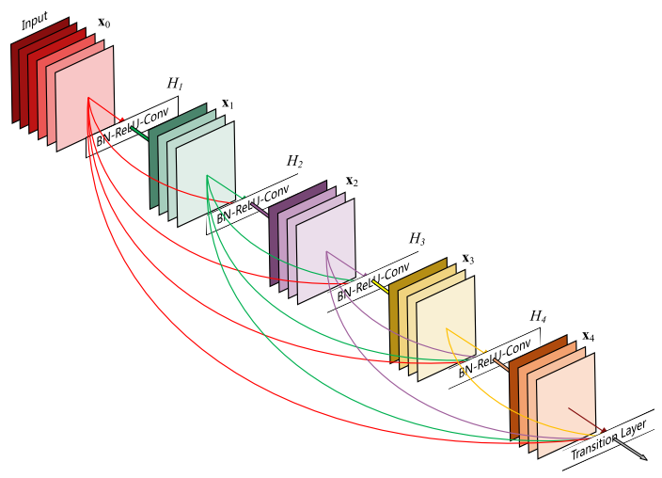
DenseNet (2016)
It connect all the layers directly with each other
At each layer, input comprises of feature maps of the previous layers and its output is passed to each subsequent layer
Feature maps are aggregated using depth wise concatenation enabling feature reuse.

Slide 37
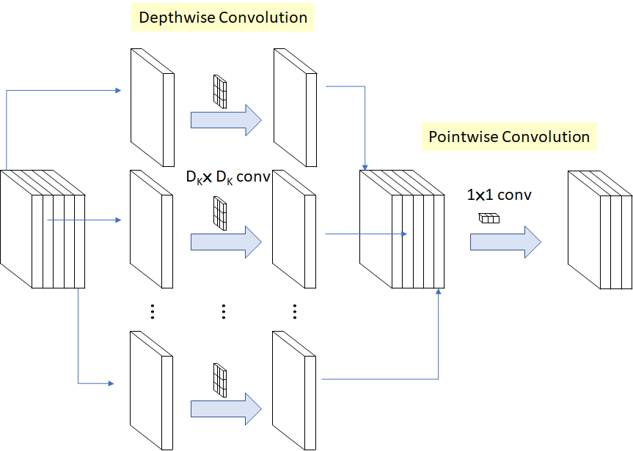
MobileNet Version 1
Has less memory foot print
Uses Depth wise Separable convolution which is depth wise convolution followed by pointwise convolution
" Apply convolution to each channel separately using a different filter and produce feature maps"

Slide 38
MobileNet
So if the input feature map is ( 15 * 15 *10) and to perform depth wise convolution 10 filters are required; if each is of size (3 *3), then
Number of computation = 15*15*10*3*3
And for point wise multiplication ; which is 1*1 convolution; to produce a output feature map with 5 channels, size of filter would be 1*1*10 (10 indicates the depth of input feature map)
Total Computation = 20250 + 10*15*15*5 = 31500
Standard Convolution where filters are of size (3*3)
Total Computation = 15*15*10*3*3*10*5 = 1012500
MobileNet reduces computation by 32%

Slide 39

Object Detection
Given an image identify the objects involved in the scene and also provide their locations

Slide 40
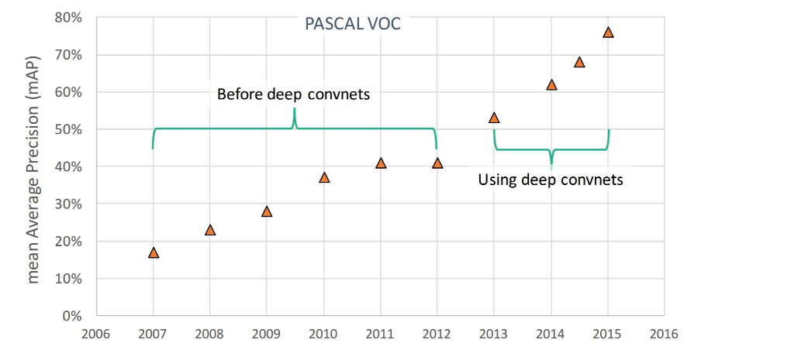
MAP (mean Average Precision)

Slide 41
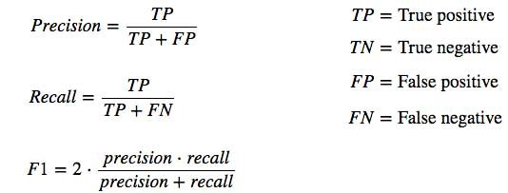
Evaluation of Object Detection Models

Slide 42
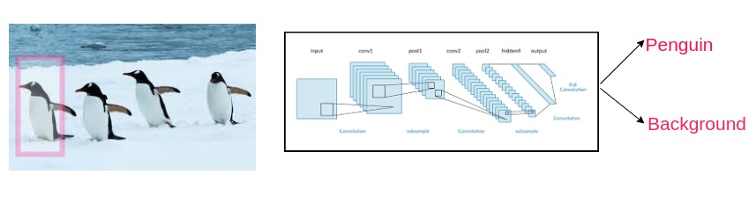
How to detect Objects using CNN?
Obvious solution could be the Sliding WIndow Approach
Apply a CNN to many different crrops of the image and CNN classifies each crop as object (or) background

Slide 43
Sliding Window
Problems inherent with the approach
Object occur in Varying shapes , sizes , aspect ratios
To find an object of size 10 *10 across 100*100 produces 8281 crop locations using sliding window approach
Computationally Infeasible

Slide 44
Using Region Proposal Algorithms
These algorithms will help in identifying crops of different aspect ratios which are likely to be objects.
The output of Region Proposal may be noisy, but it will definitely contain the crops encompassing the objects.
How do they find these objects??
Grouping adjacent pixels which share similar properties such as color and texture.

Slide 45
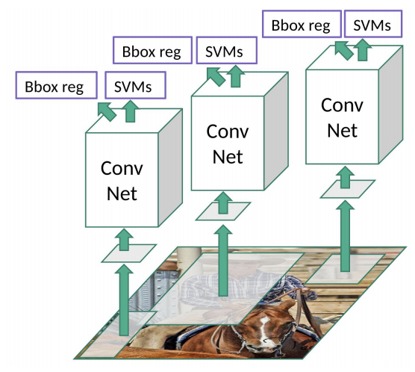
R-CNN
Regions that contain objects are selected using selective search (Region Proposal algorithm)
They are fed to CNN , the resulting features are given to SVM for predicting class label for the object
In addition, they also predict four values which are offset to locations of region proposals

Slide 46
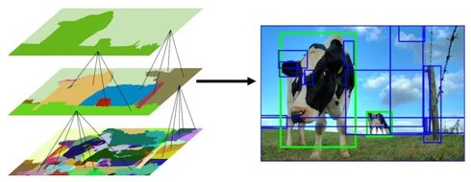
Selective Search
Selective Search is an hierarchical clustering algorithm
Which uses greedy algorithm to combine the similar regions into larger ones

Slide 47
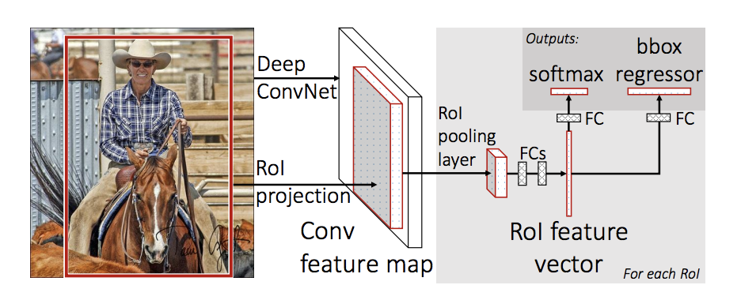
Fast R-CNN
R-CNN was extremely slow
To improve the training time, Region proposals are identified for intermediate feature maps of convolution neural network and the identified regions are warped and fed to the fully connected layer
Notes:
The reason “Fast R-CNN” is faster than R-CNN is because you don’t have to feed 2000 region proposals to the convolutional neural network every time. Instead, the convolution operation is done only once per image and a feature map is generated from it.

Slide 48
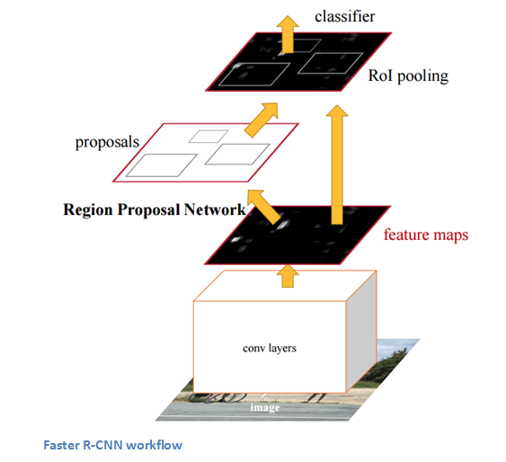
Faster R-CNN
Removes selective search from the pipeline and uses Region Proposal Network
It uses the concept of anchors. The intermediate map is divided into grids of specified size
With each grid, set of anchors are associated
Anchors which likely contain objects are corresponding regions are fed to fully connected layer to predict probability and bbox coordinates

Slide 49
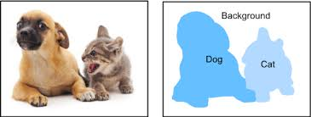
Semantic Segmentation
Label each pixel with a category

Slide 50
Patch based classification
For every pixel, consider a patch surrounding the pixel and is provided as input for CNN for prediction of class probabilities
Inefficient as it does not utilize the features computed for Overlapping patches

Slide 51
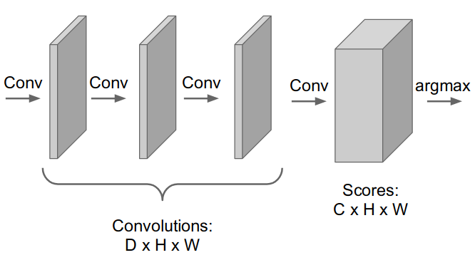
Fully Convolutional
Deigning the network with convolutional layers which performs only valid convolutions . Thus, does not reduce the feature map size
It requires huge parameters

Slide 52
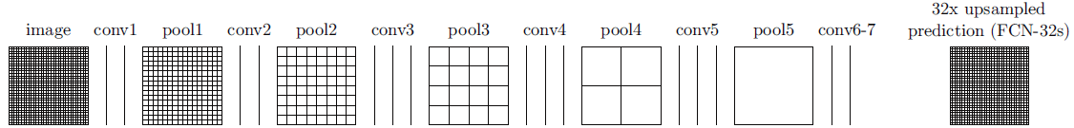
Fully Convolutional Networks
Use series of convolution layers and at the last layer restore the original image using upsampling
Spatial location information is lost and the image looks blurred

Slide 53
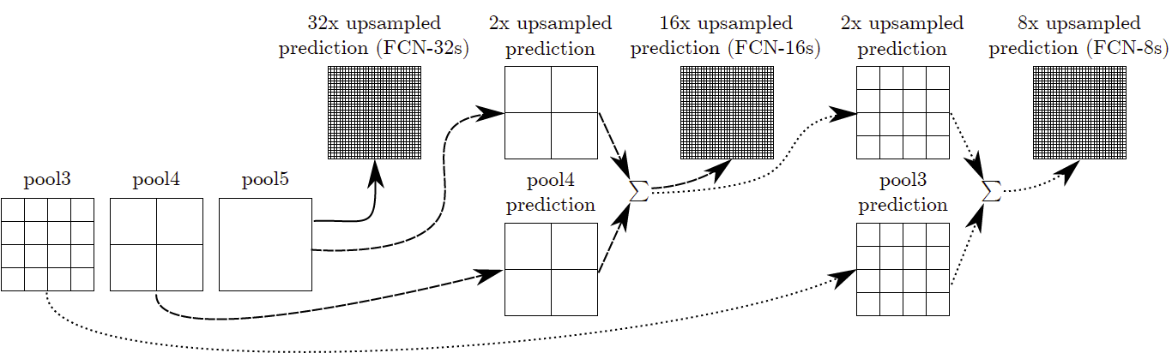
Fully Convolution Networks
Use concept of skip connections and combine the feature maps from previous layers to restore
the spatial location information

Slide 54
References
Ian Goodfellow, 'Deep Learning'
Francois Chollet, 'Deep Learning using python'
http://cs231n.stanford.edu/slides/2017/cs231n_2017_lecture11.pdf
https://towardsdatascience.com/r-cnn-fast-r-cnn-faster-r-cnn-yolo-object-detection-algorithms-36d53571365e
https://adeshpande3.github.io/adeshpande3.github.io/A-Beginner's-Guide-To-Understanding-Convolutional-Neural-Networks/

Slide 55
Thank You
Drop in your suggestions and queries at nrr.it@psgtech.ac.in
To know more about me check my github page ravitha.github.io
And projects at https://github.com/Ravitha

